Slide 1

Vanessa CHARLES
Customer churn analysis

Slide 2
Problem
Describe the business problem and define the analytic approach to solving the problem.
The problem of the telecom company is because of several rivals that are constantly trying to steal customers hence they lose their customers they automatically they lose money .
The stakeholders impacted by the problem are the company executives,the marketing team and the customer service team .
This is a huge problem for the company because losing customers is costly for any business, as it can directly affect the profitability of the company.

Slide 3
Methodology
Introduce the methods and data sources used for the analysis. Discuss your choice of variables, methods, and how they will help you address the problem.
For running statistical models or statistical analysis:
Document techniques
Document uncertainty
Document assumptions made

Slide 4
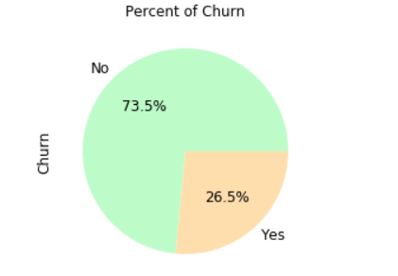
Results
There are about 26.54% of the customers churned
and 74.46% of the customers stayed.

Slide 5
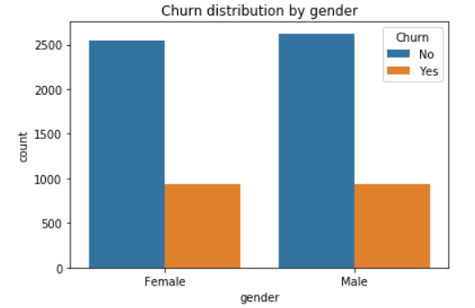
Result
The chart above is interesting, because it helps to discriminate retained and churned customers and it shows that most customers that churned had the Fiber optic internet service, and the most customers that were retained had DSL internet service.

Slide 6
Discussion & Recommendations
Communicate your recommendations to your audience. Based on your results, how might you propose solving the business problem? (June 15, 2020)
What is your proposed solution?
Sible moun ki kite cheche konn poukisa yo kite epi propose solution
What are strengths of the organization that you have leveraged in your solution?
Li ansyen sou mache a’ The leading telecom company has a massive market share, Because this company has been the market leader for so many years,
What are weaknesses of the organization that could undermine your solution?
Difikilte pou gen nouvo kliyan
What are challenges that you might encounter? How can you mitigate them?

Slide 7
References & Appendices
Provide citations for your work and provide resources for your audience to learn more about the technical aspects of your project. Share links to your GitHub repository or accompanying spreadsheets.

